Slide 1
iSense
Joseph Attia, Shriya Dale, Kyle Phillips, Evin St Clair, Lauren Tran, Franz Villarroel
1

Slide 2
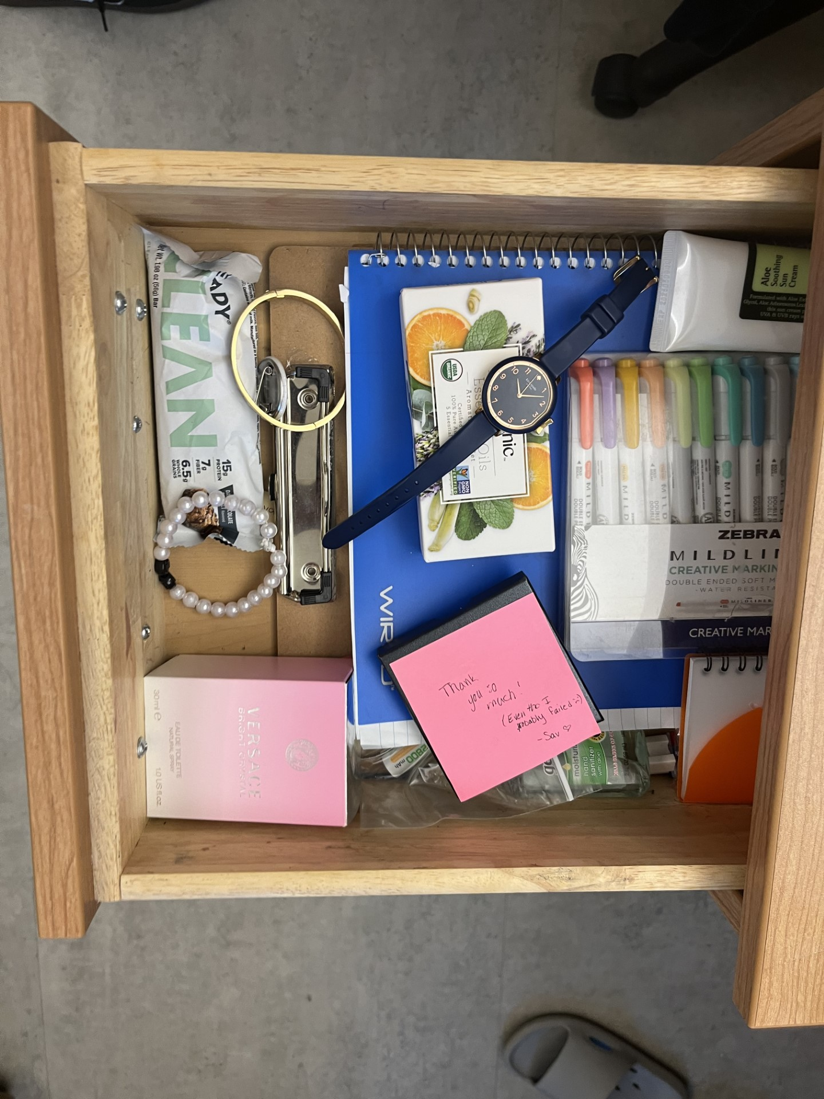
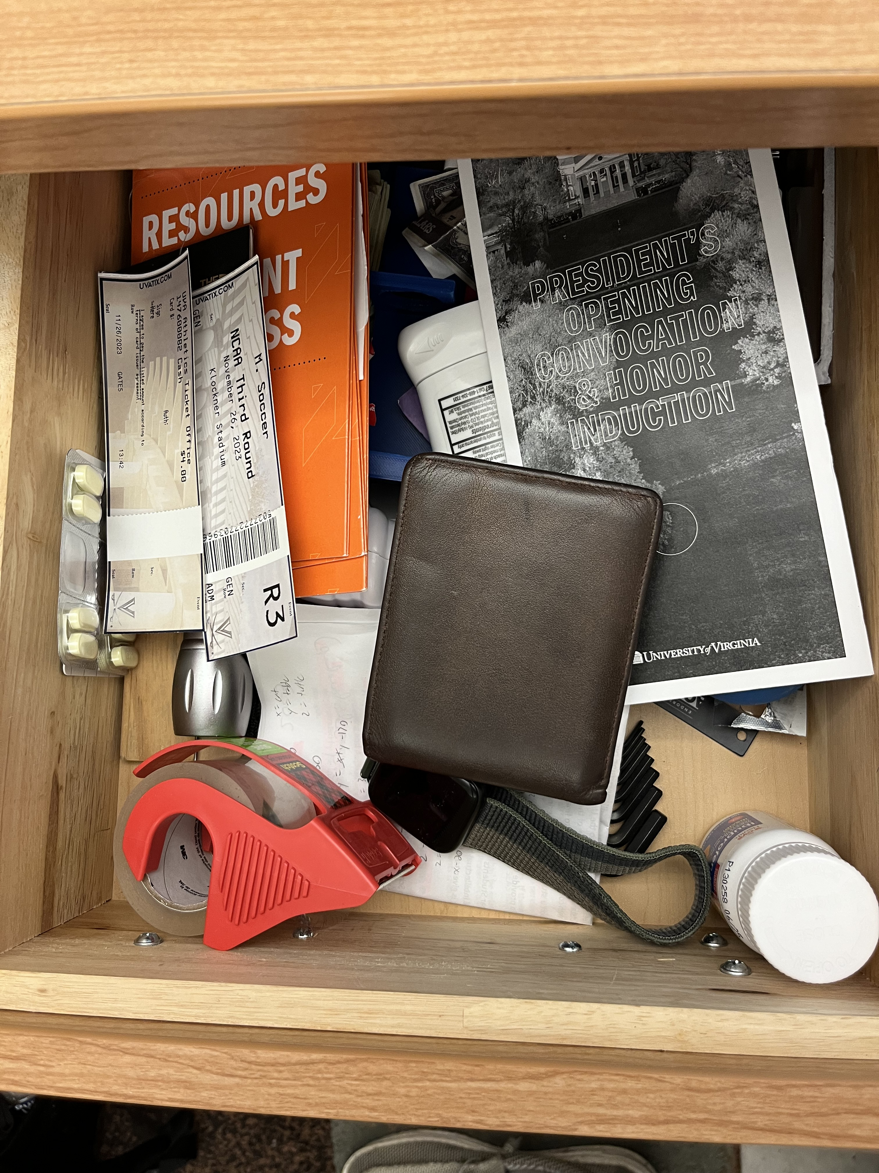
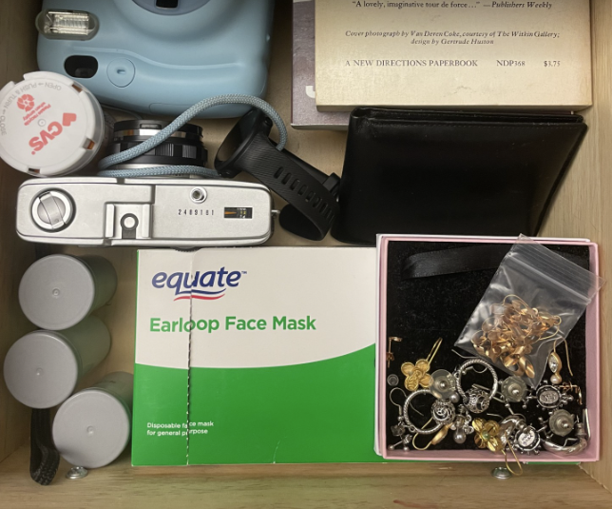
PROBLEM STATEMENT
Valuables are stored in drawers.
2
615
436
227
$227
$615
$436

Slide 3
PROBLEM STATEMENT
Valuables are stored in drawers.
$227
$615
$436
3

Slide 4
PROBLEM STATEMENT
The current state of the security market is geared towards commercial and residential properties.
4

Slide 5
PROBLEM STATEMENT
4.6 million
Continuous Untapped Customer Base
college students live in on-campus housing
https://collegeaffordability.urban.org/prices-and-expenses/room-and-board/#/room_and_board_by_type_of_institution​
https://www.bestcolleges.com/research/college-enrollment-statistics/ ​
5

Slide 6

PROBLEM STATEMENT
Security is a pressing issue for college students.
"
"
I honestly want to lock everything up because I don’t trust anyone
I had my PS3 stolen freshman year while I was in the shower.
"
"
"
"
One of my biggest reasons for being nervous about dorms is security.
I mean safes are heavy and difficult to travel with [….]
"
"
6

Slide 7
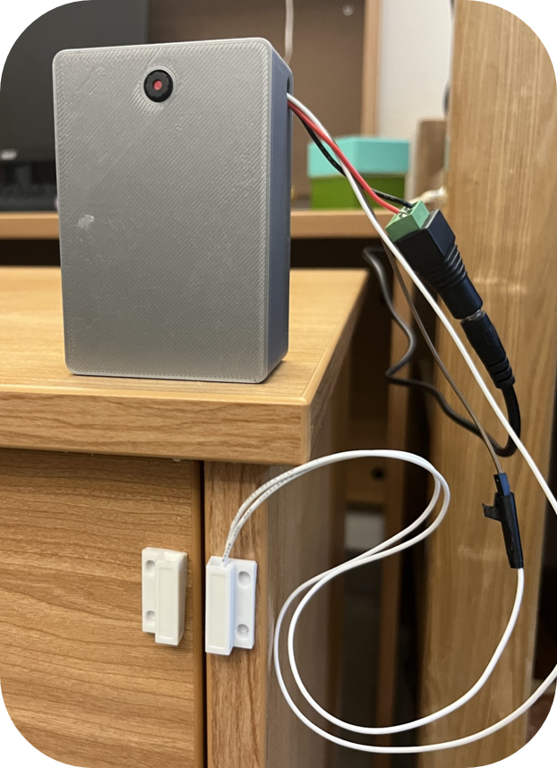
PRODUCT
Camera
Mac Address Sticker
Power Source
Physical Casing
Contact Sensor
Microcontroller
iSense detects drawer openings using contact sensors and captures images to enhance security.
7

Slide 8
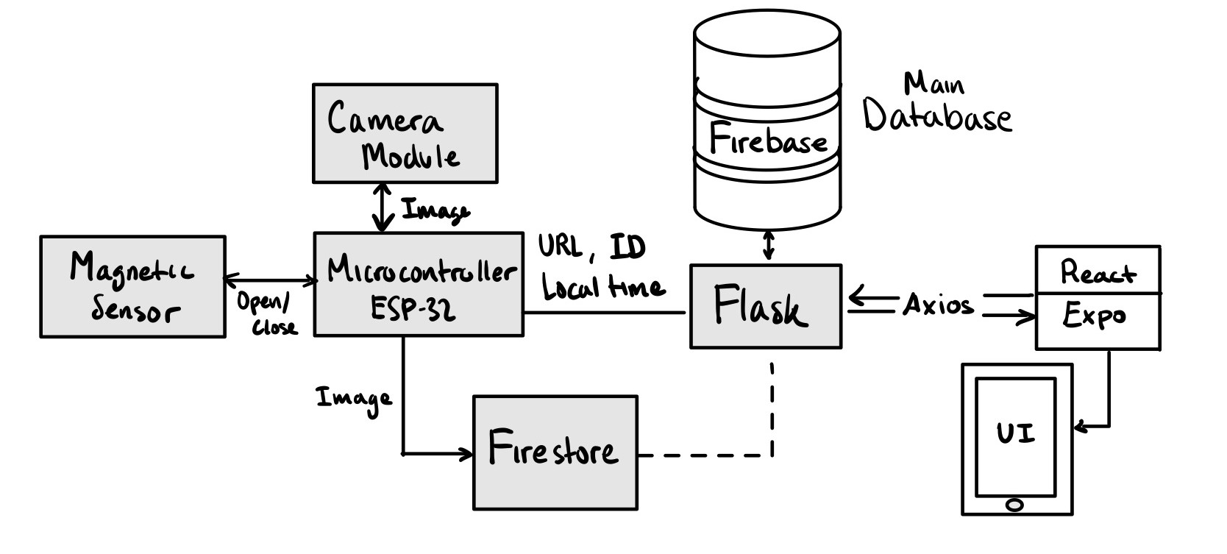
PRODUCT
SUBSYSTEM INTEGRATION
PHYSICAL CASING
BACKEND
ELECTRONICS
FRONTEND
8

Slide 9

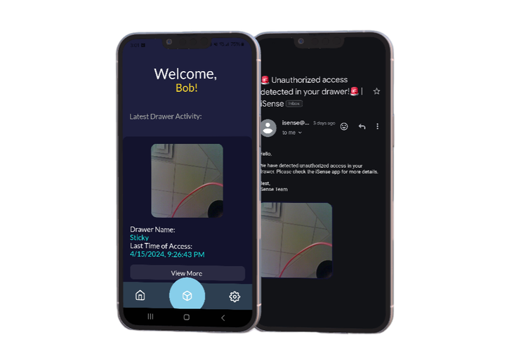
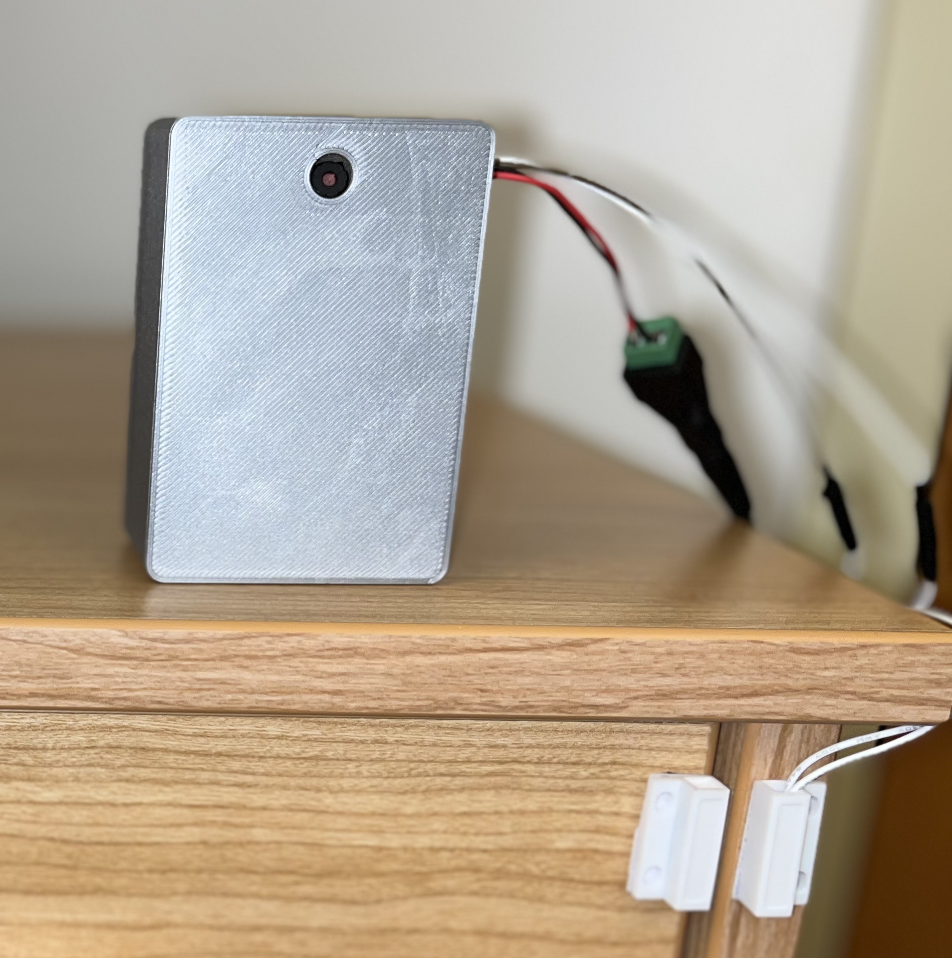
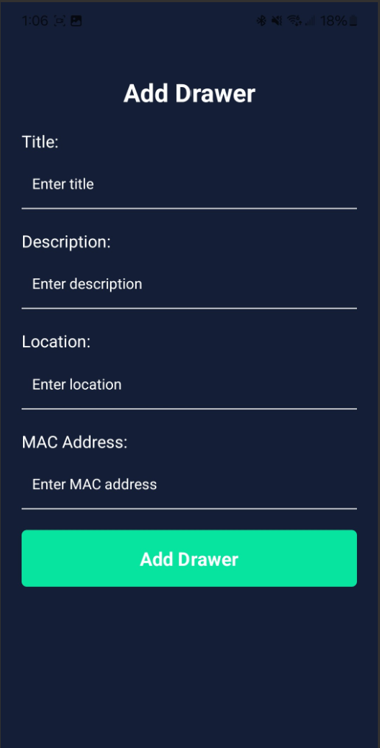
PRODUCT
THREE STEPS IS ALL IT TAKES
Peace of mind security and notifications
01
Simple and convenient setup
02
Smooth software connection
03
Contact sensors attached to desk
MAC Address to connect device to app
9

Slide 10

Peace of mind security and notifications
03
PRODUCT
01
Simple and convenient setup
02
Smooth software connection
Contact sensors attached to desk
MAC Address to connect device to app
10

Slide 11
PRODUCT
02
Peace of mind security and notifications
Seamless software connection
03
11

Slide 12
PRODUCT
03
Peace of mind security and notifications
12

Slide 13
TESTING AND KEY INSIGHTS
13

Slide 14
TESTING AND KEY INSIGHTS
KEY NEEDS
KEY DESIGN REQUIREMENTS
System runs reliably
Contact sensors recognized the drawer is open
Characteristics of a
Successful Design
User/client friendly
Take a photo when drawer position changes and user sets "armed" status in the app.
Damage free
Generate a unique home screen tailored to the user depending on their login credentials
14

Slide 15
TESTING AND KEY INSIGHTS
Testing
01
02
03
04
Students receive the device and a QR code to view the app on their phone
Students set up the device with a team member present
User uses device + app
Debrief with users regarding their experience
15

Slide 16
TESTING AND KEY INSIGHTS
Testing Metrics
5
98%
~210ms
2 MP
~3 mins
~2-4 mins
Time to send a picture from ESP32 to app
Contact Sensor Detection Rate
(< a minute)
Time for Notification to arrival in user's email
Testers
Camera Image Render Time
Camera Quality
16

Slide 17
TESTING AND KEY INSIGHTS
Testing Feedback
"
"
The majority of the time the app efficiently adds new photos quickly, however, it occasionally takes upwards of a few minutes.
The process was easy to set-up, I wish there was a confirmation that I signed up; I was visually able to understand what the app was trying to do, even though it wasn't the most aesthetically pleasing.
The process was easy to set-up, I wish there was a confirmation that I signed up; I was visually able to understand what the app was trying to do, even though it wasn't the most aesthetically pleasing.
"
"
"
It's really cool. It feels like a personal bodyguard, but wish I could place the camera in another place other than the desk.
"
The product was easy to use, but there was a bit of a delay when trying to view the images.
"
"
17

Slide 18
TESTING AND KEY INSIGHTS
An Ideal Smart Dorm...
Students expressed their interests in Smart devices.
Provides Automation and Control.
Increases Accessibility
Enhances Safety and Security
Improves General Comfort
18

Slide 19
TESTING AND KEY INSIGHTS
Driving Factors of Desirability
01
02
03
Ease of Use
Persistence of Data
Pricing
19

Slide 20


TESTING AND KEY INSIGHTS
Feasibility was a driving factor behind many design decisions, leading to a final product that should be able to be easily integrated into a more expansive smart home system.
20

Slide 21
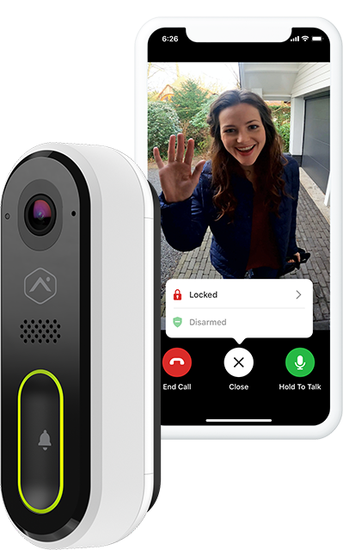
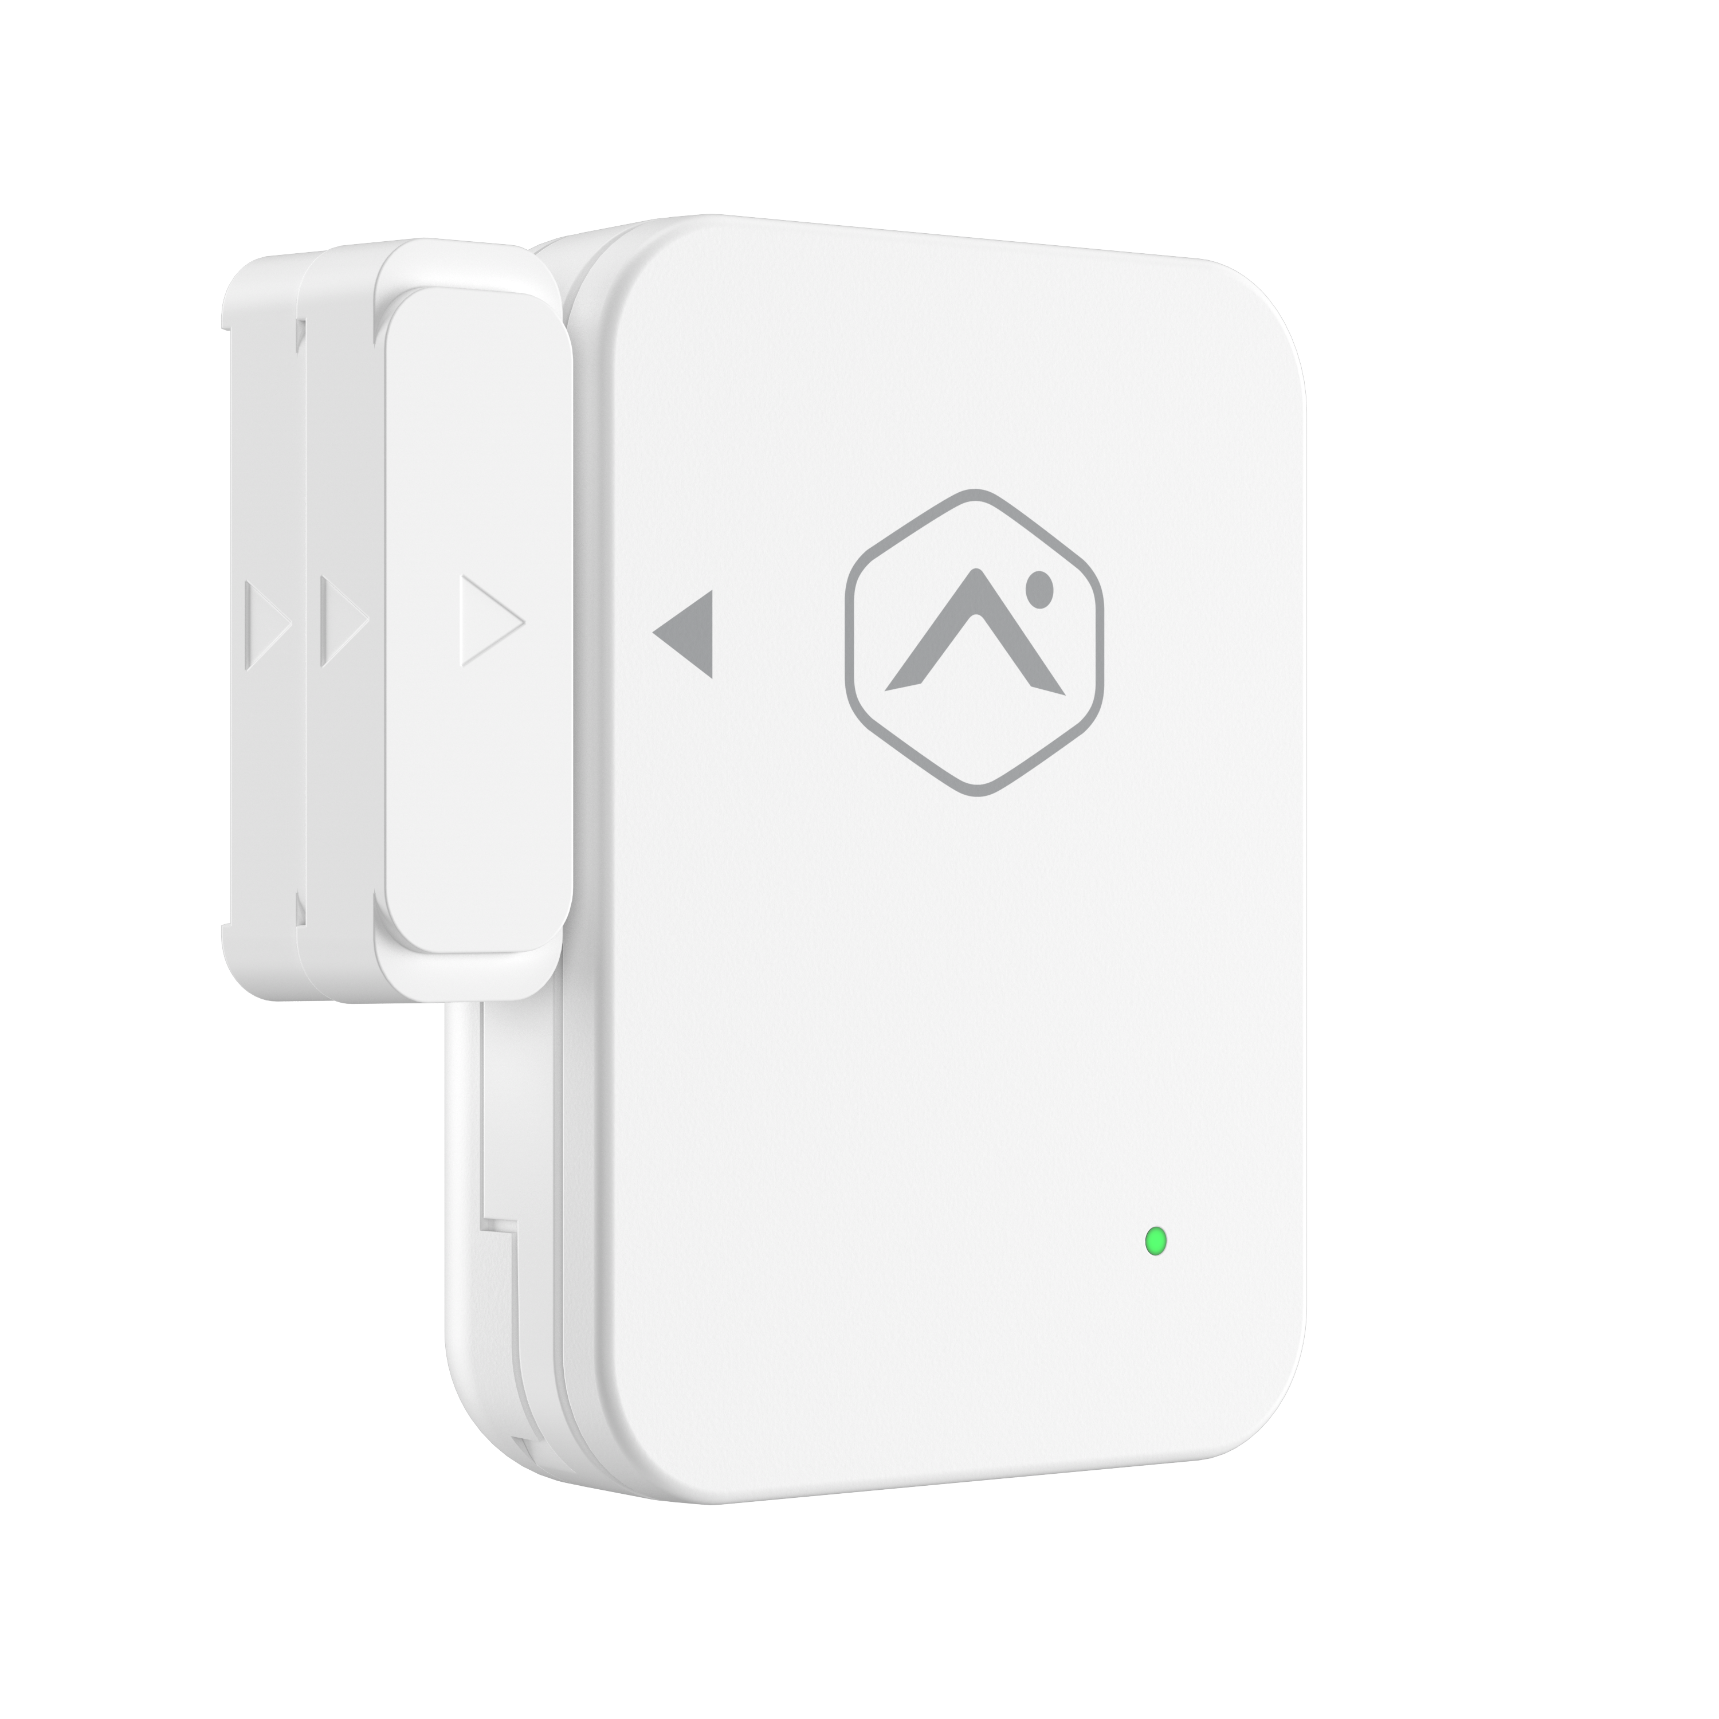
TESTING AND KEY INSIGHTS
Potential Integration with Current Solutions
PointCentral Camera
PointCentral Door Sensor
21

Slide 22
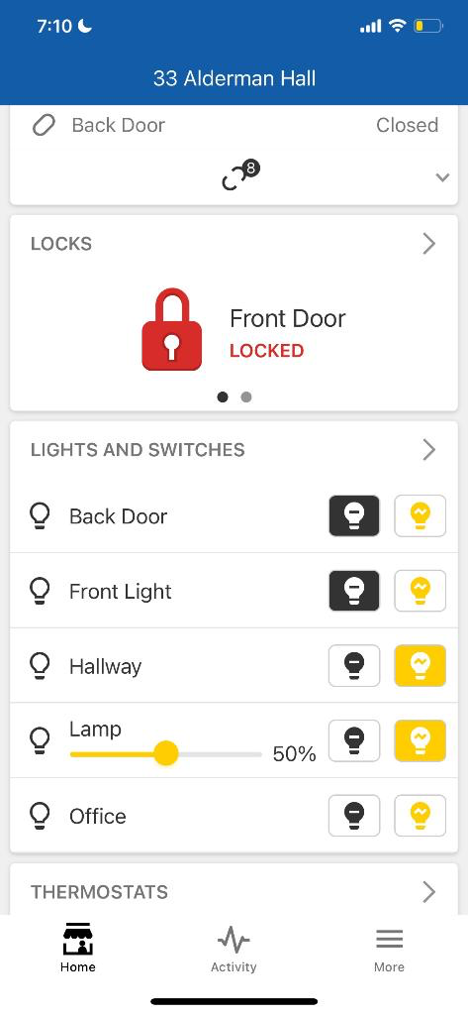
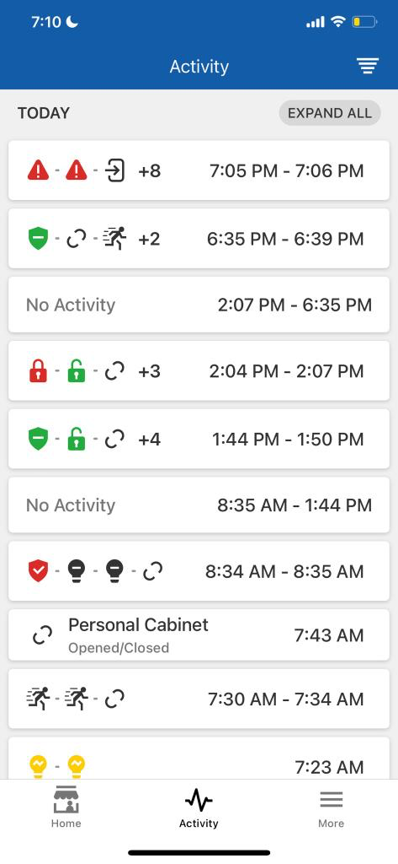
TESTING AND KEY INSIGHTS
Potential Integration with Current Solutions
Latest Status
Timestamp/Camera Roll
iSense Arm Status
22

Slide 23
TESTING AND KEY INSIGHTS
Key Insights: There are still several areas for improvement to greater meet the audience's needs.
Wireless Design
Users indicate an ideal market-product would be wireless, and either rechargeable or reliably battery powered.
Discreet Design
A more compact, easily camouflaged case for the camera would be ideal for user placement.
SMS Messages/
Push Notifications
Email notifications could go unnoticed more easily than a text message or push notification that is more prominent.
Modular Design
Users indicated that a more modular design was desirable.
Optional camera module, sensor could be placed inside drawer, etc.
System Expansion
iSense would be most beneficial as a piece of a larger Smart Dorm system:
Light control, environmental sensors, etc that adhere to the dorm constraints.
23

Slide 24
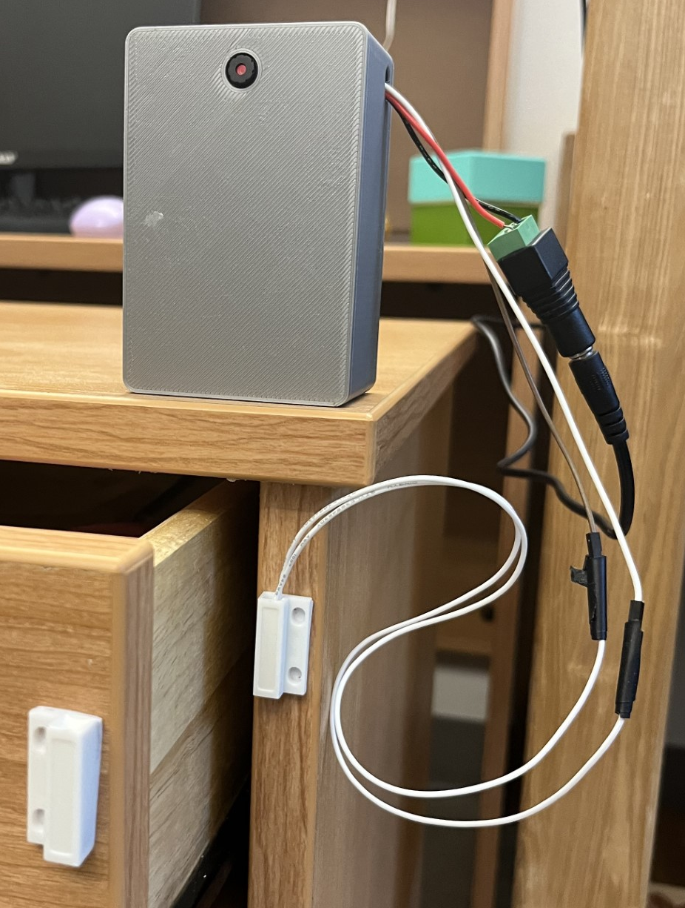
PRODUCT SUMMARY
Overall, iSense addresses drawer security concerns by being...
Effective
01
02
Non-Intrusive
03
User-Friendly
24

Slide 25
Extra Reference Slides (diagrams for subsystems)
25

Slide 26
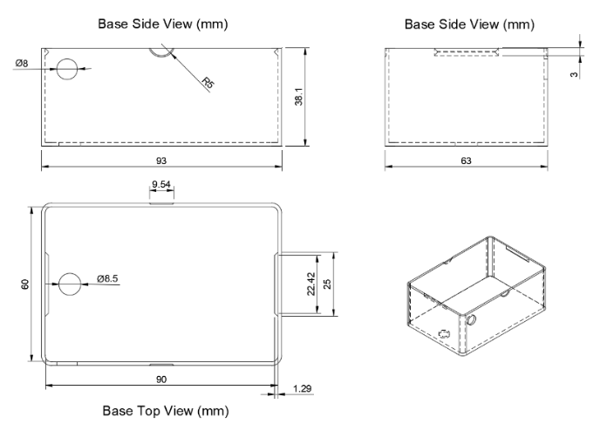
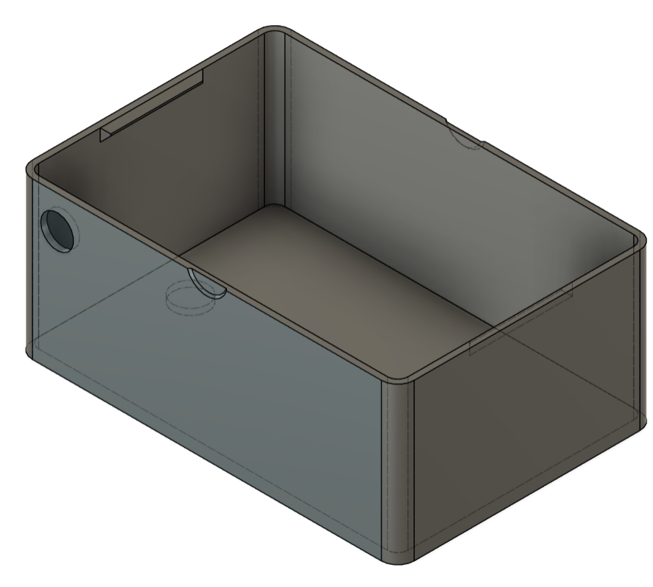
SUBSYSTEM 1: PHYSICAL CASING
26

Slide 27
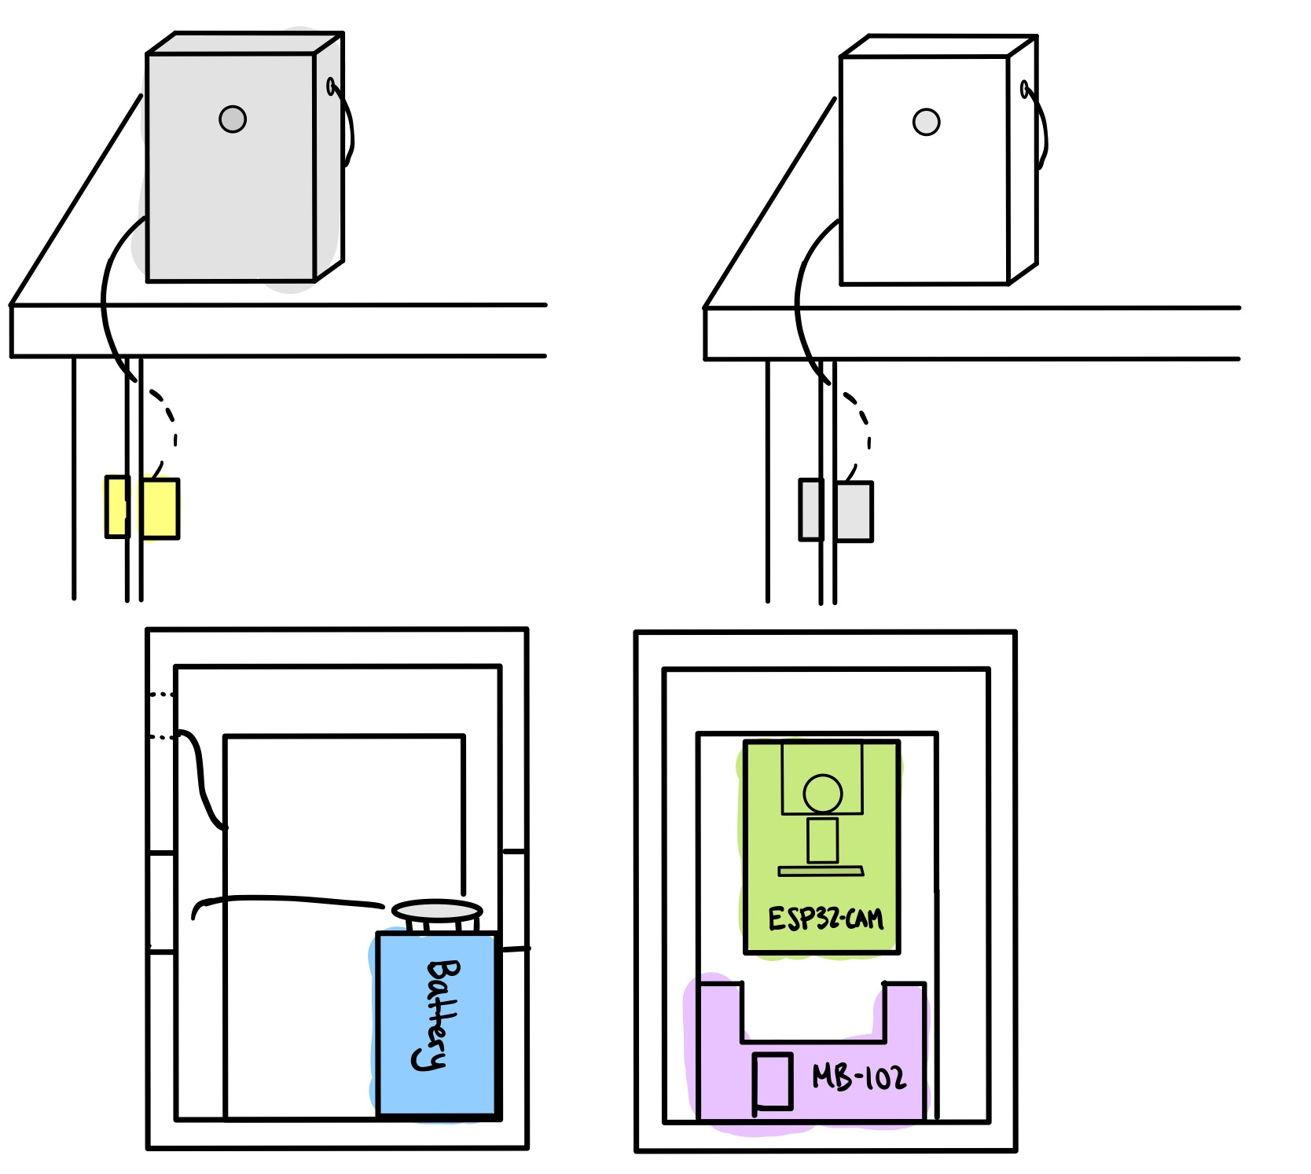
SUBSYSTEM 2: ELECTRONICS
27

Slide 28
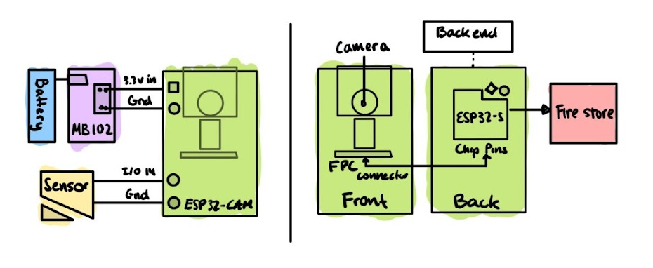
SUBSYSTEM 2: ELECTRONICS
28

Slide 29
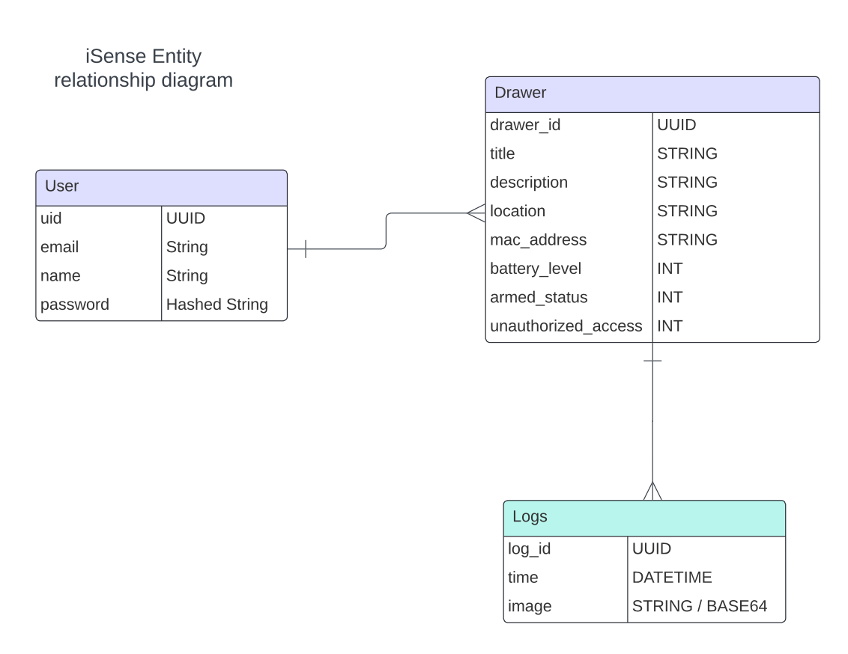
SUBSYSTEM 3 + 4: SOFTWARE FRONTEND + BACKEND
29

Slide 30
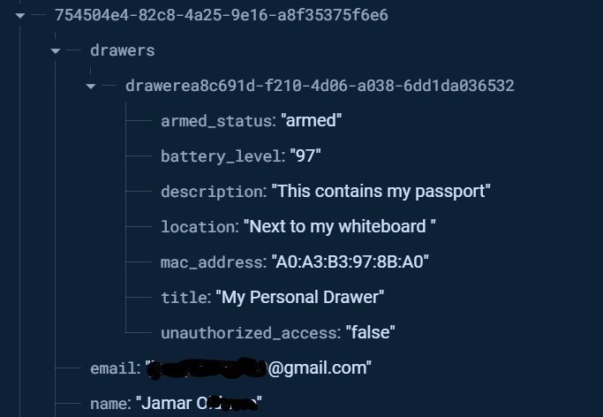
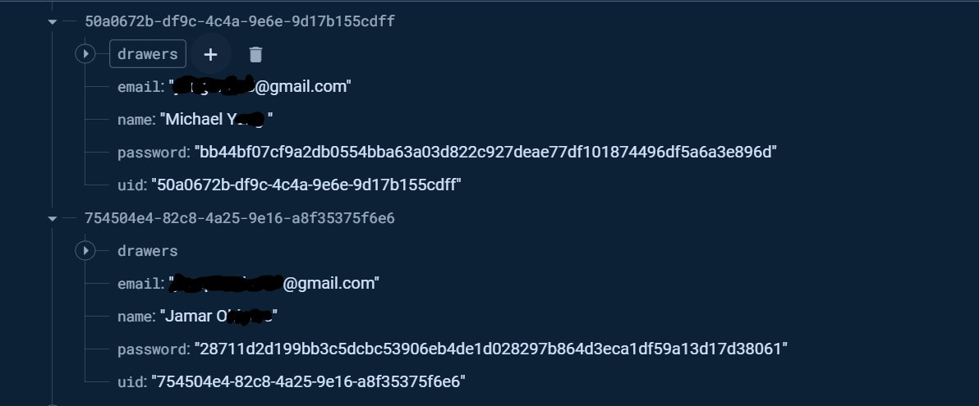
SUBSYSTEM 3 + 4: SOFTWARE FRONTEND + BACKEND
30

